Slide 1







The Road To Ethical Hacking
October 11, 2018
Technical: Basics 03: Viruses and Worms & NMAP

Slide 2
Viruses & Worms
Need a host (internet worm maker thing)
Worms: Spread without help.
Master Boot Record: files necessary for system to load, viruses that hide here do not get noticed by anti-virus.
Viruses generally spread through email.

Slide 3



Macro & Creating Viruses and Worms
Exclusive to windows.
Macros, help doing tasks.
Signatures.
Automation.
Macro programming required.
JPS Virus Maker

Slide 4
Are you under attack
List three safe lab practices in the boxes provided.
Odd computer behavior
Newly created unknown files.
Noisy computer/ Lagging

Slide 5
Safety tips
Turn of hidden file extensions
Use more than one anti-virus
Use virtual machines
Keep software and system up to date.

Slide 6
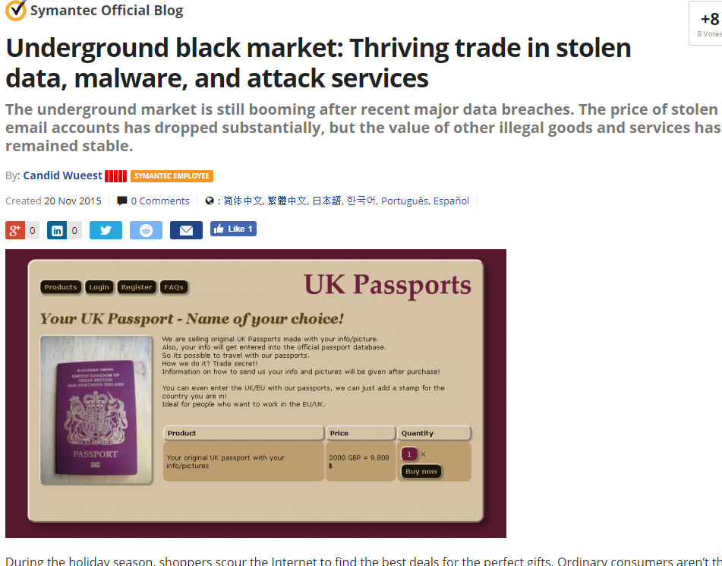
Information for sale

Slide 7
Creating a batch “virus”
Note pad:
@echo off
echo message here
shutdown -s -f -t 15 -c "Time to go to sleep!"
Shortcut
Icon
Hide
Execute
Batch Scripting
Link

Slide 8
Thank You!
Ramiro Gonzalez
rgonzalez69@ucmerced.edu
209-962-2524

